Slide 1
PS04 · NAMMA KANNADA
ಕನ್ನಡದ ಬೇರು
Kannadada Beru
A regional language explorer where words remain connected to place, people, meaning and permission.
ಪ್ರತಿಯೊಂದು ನುಡಿಗೂ ಕಥೆಯಿದೆ. ಪ್ರತಿಯೊಂದು ಕಥೆಗೂ ನೆಲವಿದೆ.
PS04 hackathon submission · October 2026
Notes:
Open with the core idea: Kannada changes across place and community, and the product keeps those stories discoverable without inventing evidence.

Slide 2
THE PROBLEM
02
Regional Kannada lives in memory, not in one searchable place
A language explorer must show difference without reducing it to stereotypes.
Scattered knowledge
Context gets lost
Voices need consent
Words and expressions live across families, local publications, dictionaries and spoken memory.
A word without locality, meaning and cultural setting can easily become a misleading regional claim.
District metadata helps discovery, but it cannot prove native variety or public recording rights by itself.
Our answer: preserve the relationship between language, land and evidence.
ಕನ್ನಡದ ಬೇರು · PS04
kannadada-beru.vercel.app
Notes:
The challenge is not a lack of words. It is the loss of context, ownership and evidence when regional language moves online.

Slide 3
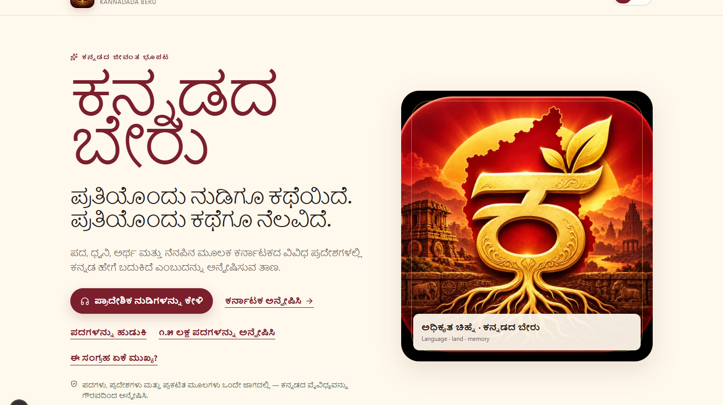
THE SOLUTION
03
One journey from place to word to voice
The homepage now leads directly to the most distinctive regional-language experience.
Judge journey
Home → Many Living Voices → district or region → comparison → Pada Beru → contribution
Kannada first
Kannada leads the interface. English and Romanization make the experience accessible without replacing the language.
ಕನ್ನಡದ ಬೇರು · PS04
kannadada-beru.vercel.app
Notes:
Live product: https://kannadada-beru.vercel.app/

Slide 4
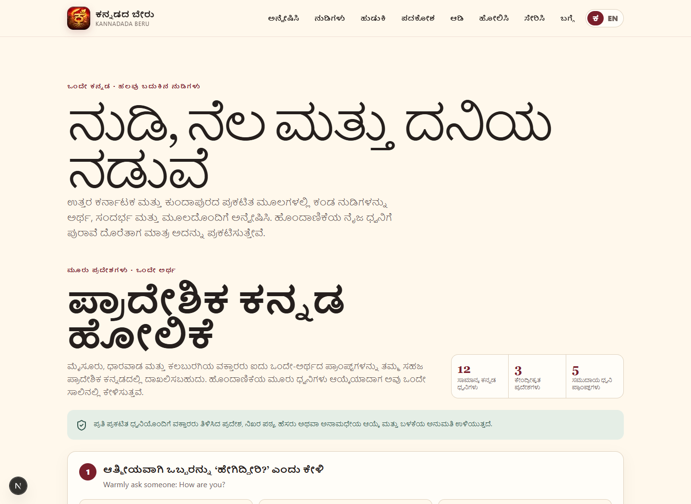
FLAGSHIP EXPERIENCE
04
ಒಂದೇ ಕನ್ನಡ · ಹಲವು ಬದುಕಿನ ನುಡಿಗಳು
One Kannada · many living voices
12 General Kannada voices
Each local OGG keeps its Commons source, speaker, date, CC0 licence and checksums. No speaker region is claimed.
5 regional voice prompts
Mysuru, Dharwad and Kalaburagi speakers can record the same five meanings in their natural regional Kannada.
ಕನ್ನಡದ ಬೇರು · PS04
kannadada-beru.vercel.app
Notes:
The published regional text sources are Kannada OneIndia (15 June 2010) and The New Indian Express (5 November 2023).

Slide 5
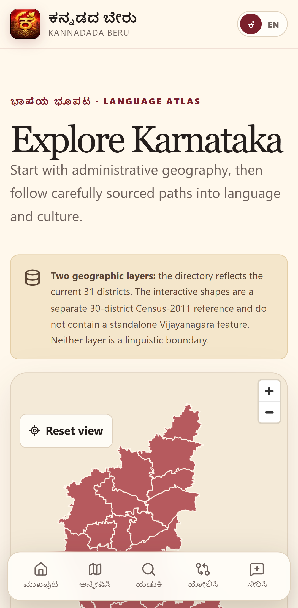
EXPLORE KARNATAKA
05
Every district opens into a bilingual story
All 31 current Karnataka districts connect history, culture, places and the wider language landscape.
31 district profiles
Map with context
Kannada and English history, local character, three places to explore, official government link and regional-language pathways.
The bundled Census 2011 geography supports navigation and is never presented as a dialect boundary.
A complete visitor journey
District pages lead back into regional words and voices instead of ending at an external government website.
ಕನ್ನಡದ ಬೇರು · PS04
kannadada-beru.vercel.app
Notes:
Geography source: DataMeet Community Maps Project, Census 2011 edition. Current district directory links use official Karnataka district sources.

Slide 6
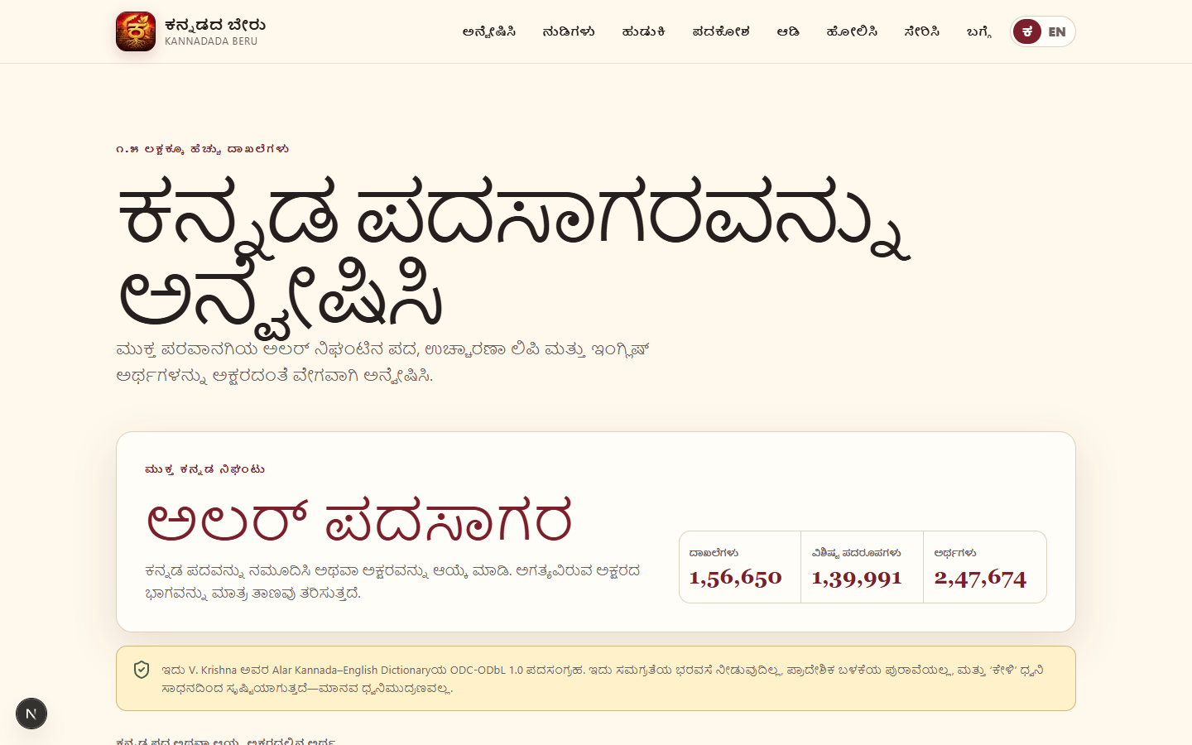
LANGUAGE ENGINE
06
156,650 Kannada-English entries without a heavy download
The open Alar dictionary is split into 50 Kannada-initial shards and loaded on demand.
Search three ways
Kannada script, Romanized Kannada and English meaning.
139,991 headwords
247,674 English definitions with direct source links.
Clear evidence layers
General dictionary entries never become regional claims through guesswork.
ಕನ್ನಡದ ಬೇರು · PS04
kannadada-beru.vercel.app
Notes:
Dictionary: V. Krishna's Alar Kannada-English Dictionary, ODC-ODbL 1.0.

Slide 7
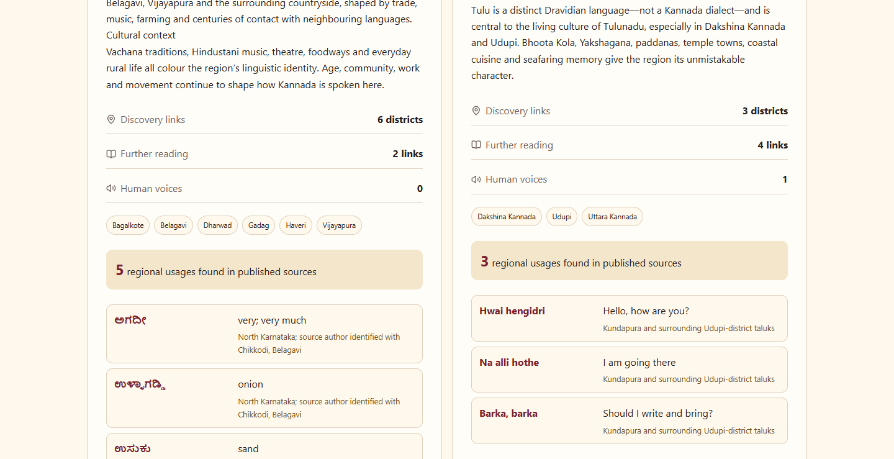
REGIONAL COMPARISON
07
Compare without flattening
Two regional portraits sit side by side with geography, culture, documented usage, sources and voice counts.
Four careful discovery regions
Old Mysuru, North Karnataka, Coastal Karnataka and Kalyana Karnataka.
No false equivalence
Unrelated words are not paired as the same concept. Read speech, spontaneous speech, vocabulary and pronunciation remain distinct.
ಕನ್ನಡದ ಬೇರು · PS04
kannadada-beru.vercel.app
Notes:
Research framing draws on the 2025 Kannada dialect identification study and A Manual of Modern Kannada.

Slide 8
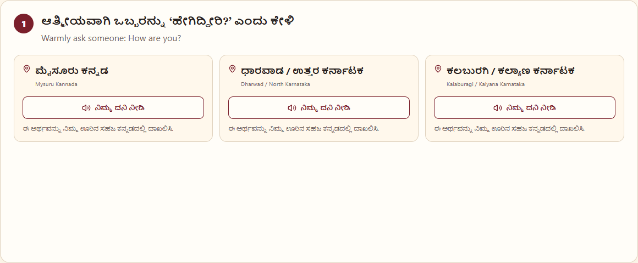
VOICE AND PROVENANCE
08
Audio with visible provenance
Twelve Kannada clips are available now, each with its source, credit, date and licence.
12 integrity checked OGG files
Exact word, uploader, source date, public file page, CC0 status, byte length and SHA-256 stay together in the manifest.
Community voice collection
Five shared meanings invite natural expressions from Mysuru, Dharwad and Kalaburagi, with transcript, region, credit and permission kept together.
ಕನ್ನಡದ ಬೇರು · PS04
kannadada-beru.vercel.app
Notes:
Each bundled recording keeps its exact source page, credit, date and licence in the public audio manifest.

Slide 9
REGIONAL VOICE COLLECTION
09
Community voices become regional listening
Speakers contribute from a phone through a private, permission-led workflow.
Three focus regions
Five shared meanings
Private contribution flow
Mysuru, Dharwad and Kalaburagi anchor a clear, comparable regional listening experience.
Greeting, meal check, come here, heavy rain and let us go home. Regional wording stays natural.
Phone recording, exact Kannada transcript, region, attribution choice and publication permission travel together.
12 General Kannada references · 5 community prompts · secure private uploads
ಕನ್ನಡದ ಬೇರು · PS04
kannadada-beru.vercel.app
Notes:
The contribution experience is live at https://kannadada-beru.vercel.app/contribute/audio

Slide 10
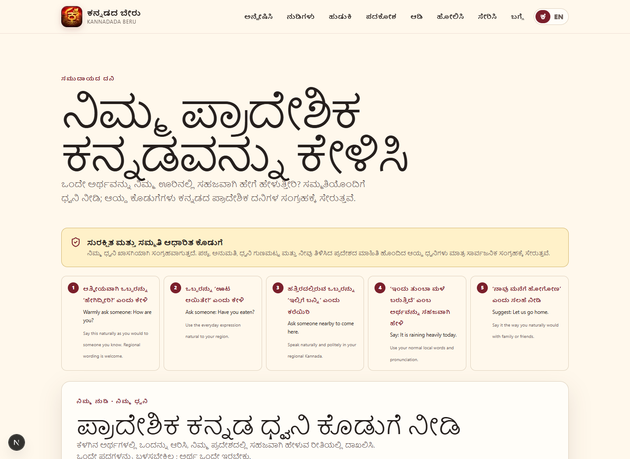
LEARNING AND PARTICIPATION
10
Discovery becomes play, then a shared voice
The experience closes by inviting every region into the collection.
Pada Beru
Ten rounds of Kannada ↔ English meaning challenges with score, streak, hints and optional device pronunciation.
Regional voice contribution
Choose a shared meaning, record naturally, add the exact Kannada transcript, set credit and permission, then send securely.
ಕನ್ನಡದ ಬೇರು · PS04
kannadada-beru.vercel.app
Notes:
Show the five shared meanings, phone recording control, region choice, exact transcript and permission fields.

Slide 11
PRODUCT ARCHITECTURE
11
Static-first, private by default, built for ordinary phones
No account, paid API, map token or external database is needed for the core journey.
Next.js 16 · React 19
Local data layers
Interaction
Static App Router pages, strict TypeScript, installable PWA and offline shell.
31 district profiles, 8 regional usages, 12 audio files, local GeoJSON and 50 dictionary shards.
MapLibre atlas, search, comparison, audio player, Pada Beru and regional voice contribution.
Delivery
Quality
Privacy
Licensing
Vercel HTTPS and CDN
Vitest and Playwright
Private audio storage
Attribution stays visible
Open source · MIT code licence · third-party data keeps its own terms
ಕನ್ನಡದ ಬೇರು · PS04
kannadada-beru.vercel.app
Notes:
Architecture details: docs/ARCHITECTURE.md in the repository.

Slide 12
RELEASE PROOF
12
Tested across the complete public experience
The release gate checks source contracts, production generation and real browser journeys.
54 / 54
52
52 pass
0
unit tests across 17 files
generated production pages
Android and desktop journeys, including offline PWA reopening
known production dependency vulnerabilities
Atlas · district learning · regional voices · dictionary · comparison · audio · game · contribution · PWA
Live production verified at kannadada-beru.vercel.app
ಕನ್ನಡದ ಬೇರು · PS04
kannadada-beru.vercel.app
Notes:
Final release verification completed on 22 October 2026 across local production and live deployment checks.

Slide 13
ಕನ್ನಡದ ಬೇರು
A language survives when people can find their own place inside it.
Kannadada Beru lets people across Karnataka discover a familiar word, understand its story and add the living voice that carries it forward.
Live app
GitHub
kannadada-beru.vercel.app
github.com/DSGAMING98/kannadada-beru
ನಮ್ಮ ನುಡಿ · ನಮ್ಮ ಬೇರು · ನಮ್ಮ ಹೆಮ್ಮೆ
Notes:
Close with the live demo and the project's respect-first standard for regional language.

